Slide 1


Tree st
A social discovery tool for organizations
PATENT PENDING – CONFIDENTIAL – DO NOT SHARE – PATENT PENDING – CONFIDENTIAL – DO NOT SHARE - PATENT PENDING – CONFIDENTIAL – DO NOT SHARE – PATENT PENDING – CONFIDENTIAL

Slide 2
Contents
Project Overview
Why Social Discovery?
Problem Summary
Competition Case Study (LinkedIn)
How Tree.st Works
Validation Case Study (MIT)
Competition & Monetization
Team
Appendix A-E
PATENT PENDING – CONFIDENTIAL – DO NOT SHARE – PATENT PENDING – CONFIDENTIAL – DO NOT SHARE - PATENT PENDING – CONFIDENTIAL – DO NOT SHARE – PATENT PENDING – CONFIDENTIAL

Slide 3
Tree.st / Project Overview
In the span of one year, Tree.st’s main product was developed from the ground up via 60+ face-to-face interviews
MAIN PRODUCT
Developed, http://www.tree.st
DEMO VIDEOS
http://www.tree.st/d/how
DEMO COMMUNITY
http://www.tree.st/mit
INTELLECTUAL PROPERTY
1 Provisional
VALIDATION
Tested with 700+ users
Product-market-fit shown
NEXT STEPS
Develop commercialization page
Develop marketing material
Develop sales funnel
Customer-acquisition validation
PATENT PENDING – CONFIDENTIAL – DO NOT SHARE – PATENT PENDING – CONFIDENTIAL – DO NOT SHARE - PATENT PENDING – CONFIDENTIAL – DO NOT SHARE – PATENT PENDING – CONFIDENTIAL

Slide 4
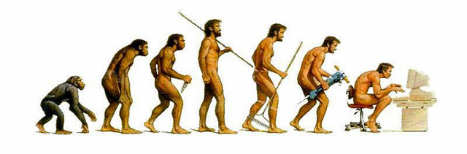
Tree.st / Why Social Discovery?
Humans are social beings. To socialize, we group ourselves based on the traits we find in the people around us
Vision allowed the caveman to see physical traits in others to build teams to achieve goals and innovate
Today we are blind, as there are few tools for individuals in organizations find one another based on knowledge or intellectual traits
PATENT PENDING – CONFIDENTIAL – DO NOT SHARE – PATENT PENDING – CONFIDENTIAL – DO NOT SHARE - PATENT PENDING – CONFIDENTIAL – DO NOT SHARE – PATENT PENDING – CONFIDENTIAL

Slide 5



Tree.st / Problem Summary
As globalization removes national barriers, companies will compete more and more on a global level. As a consequence, the innovation these companies generate will be the greatest differentiator between winners and losers.
The greatest barrier of innovation is silo-ed thinking. Departmental silos, program silos, functional silos, and cultural silos – impede innovation at organizations from taking place. If silo-ed thinking is innovation’s greatest barrier, inter-disciplinary, inter-cultural and inter-departmental communication is its greatest driver¹.
This is an urgent and very real problem. Much research from Prof. Piskorski (HBS)², Anthony J. Bradley (VP at Gartner Research)³, among other premier research groups has been done in this space. When one analyzes why Kodak’s market share has significantly dropped, or why Apple has exploded with success, the existence or the lack of silo-ed communication is at the center of the conversation.
[1] “Medici Effect.” [2] Piskorski, Mikolaj Jan. "Social Strategies That Work." Harvard Business Review 89, no. 11 (November 2011): 116–122. [3] Bradley, Anthony J. “The Social Organization.” Harvard Review Press
PATENT PENDING – CONFIDENTIAL – DO NOT SHARE – PATENT PENDING – CONFIDENTIAL – DO NOT SHARE - PATENT PENDING – CONFIDENTIAL – DO NOT SHARE – PATENT PENDING – CONFIDENTIAL

Slide 6


Tree.st / Competitive Case Study
KEY
Macro quality
Case study: LinkedIn & Yammer
LinkedIn & Yammer only gather macro-level qualities about professionals, such as their education, fields, roles, etc.
Tree.st on the other hand gathers micro-level qualities specific for each profession, enabling professionals to find one another via complex searches
That way, if Tree.st were to create job-specific communities…
All 3rd grade teachers could find one another and begin creating better curricula
All anesthesiologists that use XYZ drug could find one another and discuss patient side-effects
All MBA students nationwide could find each other based on interests, goals, ambitions
Micro quality
Macro
Role
Career
Education
Location
Micro
Professions
Lawyers
Doctors
Pilots
Pepsi
Personality
Patients
Airplanes
…
Judges
Specialties
Licenses
…
Cases
Approach
Experience
…
Wins
Work Style
Airports
…
Tree.st
PATENT PENDING – CONFIDENTIAL – DO NOT SHARE – PATENT PENDING – CONFIDENTIAL – DO NOT SHARE - PATENT PENDING – CONFIDENTIAL – DO NOT SHARE – PATENT PENDING – CONFIDENTIAL

Slide 7



Tree.st / How Tree.st Works
Tree.st unites organizations via a four-step process that encourages social discoverability
GATHER
SEARCH
GROUPS
COMMUNICATE
We first ask members a series of questions to gather micro-level qualities
Enable users to search for others based on the same unique qualities that were gathered
Members create groups based on a defined set of qualities – aka “Smart Groups”
Communication is where value is created. Tree.st incentivizes members to reach goals
Appendix A
Appendix B
Appendix C
Appendix D
Tree.st communities have a strong sense of purpose
Via optional gamification modules and challenges we create a culture of innovation
Social Discovery
Gamification & Goals
Innovation
Creates a medium where members can connect
Incentivizes members to create diverse teams to solve challenges
Results where business value can be derived
PATENT PENDING – CONFIDENTIAL – DO NOT SHARE – PATENT PENDING – CONFIDENTIAL – DO NOT SHARE - PATENT PENDING – CONFIDENTIAL – DO NOT SHARE – PATENT PENDING – CONFIDENTIAL

Slide 8
Tree.st / Validation at MIT
We validated Tree.st at MIT with 700+ students by creating three nested communities
MIT
Currently 10% of MIT graduates use Tree.st to find each one another based on a number of unique qualities never before gathered – including “shoe size”
Potential inter-departmental collaborations led to a meeting with Dean of Graduate Students and the Dean of Student Life to potentially institutionalize the MIT Tree.st community in the coming years
10% of MIT graduates
Inter-departmental comm.
Improved student life
MIT SLOAN
In the first two weeks on Fall 2012 40% of all current MIT Sloan students joined the MIT Sloan Tree.st community. Each was characterize with 45 unique qualities. The MIT Sloan Tree.st community became the one and only place where MIT Sloan students could easily discover others. For example: all the female, gluten-free, ex-consultants living in Central Square connected with one another. Tool created enough attention to create a news article in school newsletter
40% of school in 2 weeks
45 unique qualities
20+ “Smart Groups”
ENTREPRENEURSHIP & INNOVATION TRACK
Prof. Edward Roberts saw value in the Tree.st to create diverse entrepreneurial teams for the Entrepreneurship Track. MIT Sloan Entrepreneurs grouped themselves before school started by industry, geographical region, and goals of interest. This allowed the innovators to begin communicating with one another before classes began
Soon we were contacted by Peter Thiel’s (founder PayPal) Foundation to setup a similar community for their mentor mentee network
58 unique qualities
Grouped by industry
Contacted by Peter Thiel’s Foundation
PATENT PENDING – CONFIDENTIAL – DO NOT SHARE – PATENT PENDING – CONFIDENTIAL – DO NOT SHARE - PATENT PENDING – CONFIDENTIAL – DO NOT SHARE – PATENT PENDING – CONFIDENTIAL

Slide 9
Tree.st / Competition & Monetization
Competition
For professional discoverability only
Negligible for other industries
Monetization, LV, and Scale
Appendix A
DIRECT
MONETIZATION
N/A
Initially pure-play B2B SaaS model, later will add on-premise solution for enterprises, followed by public facing Tree.st communities for niche-populations using an advertisement model
POTENTIALLY DIRECT
Ark.com
Consumer social discoverability tool, combines Facebook and LinkedIn data in a search engine
Series A $4M (2011)
LIFETIME VALUE
We expect customer lifetime value to be high since Tree.st collects micro-level qualities not available anywhere else. Though customer has data ownership, the Tree.st data structure and intellectual property makes it impractical for customer use
Yammer.com
Requires infrastructure changes to gather micro-level qualities for each client and a search tool to create discoverability feature
SCALE
INDIRECT
Given the decentralized nature of the engineering behind Tree.st – scalability is not a problem. Most initial capital will be used for sales and marketing after customer acquisition validation is complete
LinkedIn.com
Contains a professional social discoverability feature, monetization requires search engine to have limited usage to most users
Among others…
PATENT PENDING – CONFIDENTIAL – DO NOT SHARE – PATENT PENDING – CONFIDENTIAL – DO NOT SHARE - PATENT PENDING – CONFIDENTIAL – DO NOT SHARE – PATENT PENDING – CONFIDENTIAL

Slide 10



Tree.st / Team
UC Berkeley Bioengineer/CS; Co-founded startups in high school with profits of $200K per year; First employee of startup with $4M Series A, startup raised $22.5M in Series B. Lead software engineer for a large-data genomic projects with the DOE at LLNL. MIT Sloan MBA 2013.
Northwestern University/Industrial Engineering; 4yrs corporate banking at HSBC Bank in the chemicals sector. Co-founder of an investment partnership with former Northwestern professor. MIT Sloan MBA 2014
Omid Sadeghpour
Shailesh Mittal
Technology
Sales
MIT Sloan Fellow '13, Lawyer, LL.M. Established and led the legal department of an international media representative; managed business and contractual negotiations with high-tech startups; developed e-business initiatives.
Jan Widmer
Strategy
PATENT PENDING – CONFIDENTIAL – DO NOT SHARE – PATENT PENDING – CONFIDENTIAL – DO NOT SHARE - PATENT PENDING – CONFIDENTIAL – DO NOT SHARE – PATENT PENDING – CONFIDENTIAL

Slide 11

Thank you
PATENT PENDING – CONFIDENTIAL – DO NOT SHARE – PATENT PENDING – CONFIDENTIAL – DO NOT SHARE - PATENT PENDING – CONFIDENTIAL – DO NOT SHARE – PATENT PENDING – CONFIDENTIAL

Slide 12
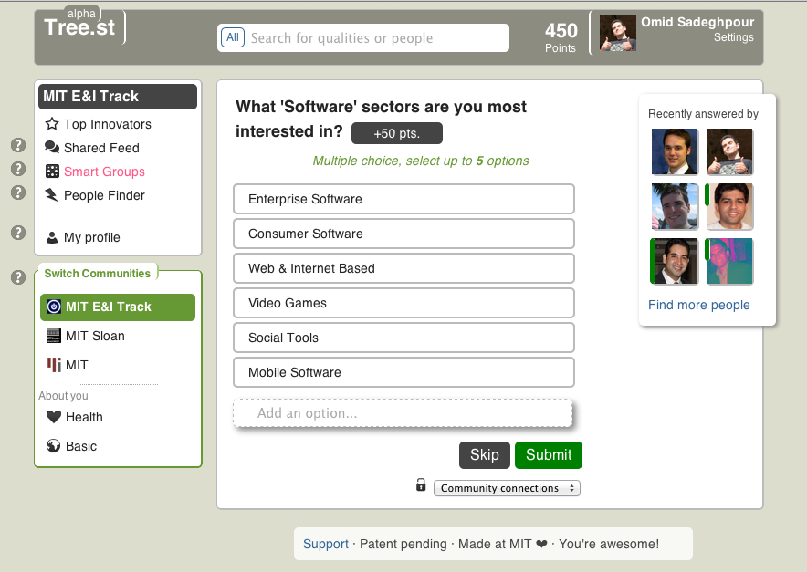
Tree.st / Appendix A – Quality Gathering
PATENT PENDING – CONFIDENTIAL – DO NOT SHARE – PATENT PENDING – CONFIDENTIAL – DO NOT SHARE - PATENT PENDING – CONFIDENTIAL – DO NOT SHARE – PATENT PENDING – CONFIDENTIAL

Slide 13
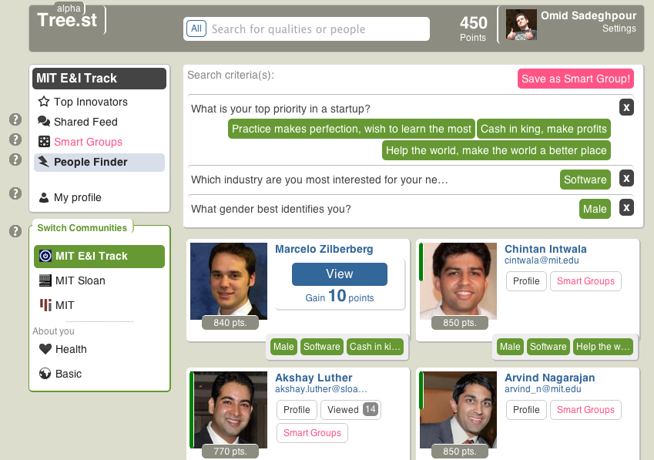
Tree.st / Appendix B – People Finder
PATENT PENDING – CONFIDENTIAL – DO NOT SHARE – PATENT PENDING – CONFIDENTIAL – DO NOT SHARE - PATENT PENDING – CONFIDENTIAL – DO NOT SHARE – PATENT PENDING – CONFIDENTIAL

Slide 14
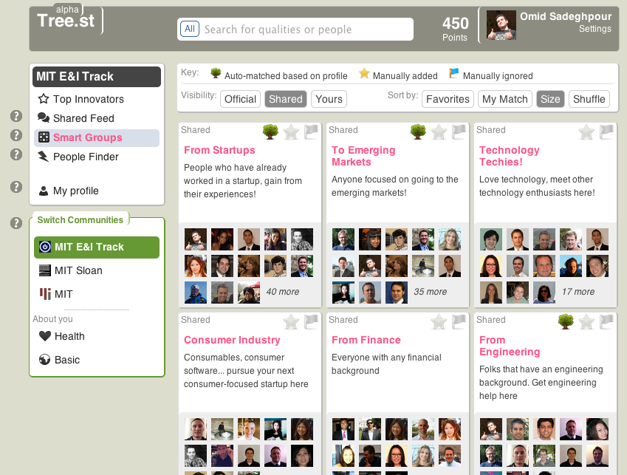
Tree.st / Appendix C – Smart Groups
PATENT PENDING – CONFIDENTIAL – DO NOT SHARE – PATENT PENDING – CONFIDENTIAL – DO NOT SHARE - PATENT PENDING – CONFIDENTIAL – DO NOT SHARE – PATENT PENDING – CONFIDENTIAL

Slide 15
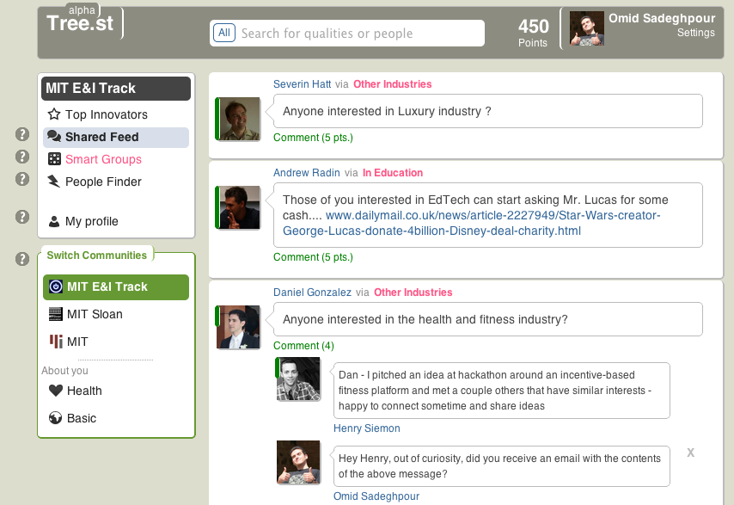
Tree.st / Appendix D – Shared Feed
PATENT PENDING – CONFIDENTIAL – DO NOT SHARE – PATENT PENDING – CONFIDENTIAL – DO NOT SHARE - PATENT PENDING – CONFIDENTIAL – DO NOT SHARE – PATENT PENDING – CONFIDENTIAL

Slide 16
Tree.st / Appendix E - Financials
With two product tiers (SaaS & Enterprise in-location) we will breakeven in 14 quarters (3.5 years). We expect to spend capital early on in marketing and sales. Given our projections, Tree.st will have early stage financials similar to LinkedIn and Microsoft
PATENT PENDING – CONFIDENTIAL – DO NOT SHARE – PATENT PENDING – CONFIDENTIAL – DO NOT SHARE - PATENT PENDING – CONFIDENTIAL – DO NOT SHARE – PATENT PENDING – CONFIDENTIAL

